Slide 1
A Whirlwind Summary of Plasma Fluid Theory
C. Schiff – 9/23/2018
Based on Fitzpatricks notes

Slide 2
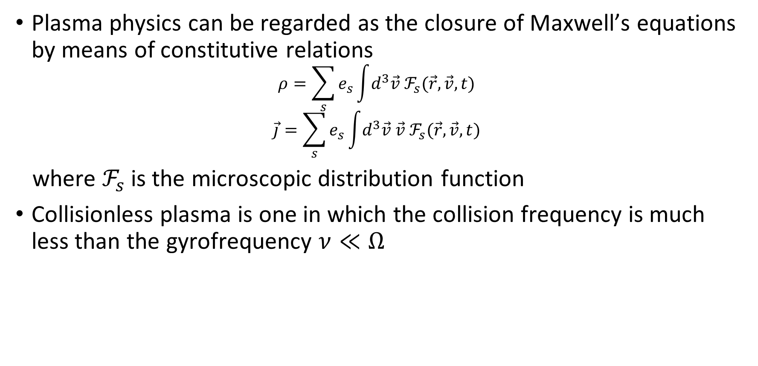
Collisions
Plasma physics can be regarded as the closure of Maxwell’s equations by means of constitutive relations
$$ρ=\sum_{s}{e_{s}\int{d^{3}\vec{v} ℱ_{s}(\vec{r},\vec{v},t)}}$$
$$\vec{j}=\sum_{s}{e_{s}\int{d^{3}\vec{v} \vec{v} ℱ_{s}(\vec{r},\vec{v},t)}}$$
where $ℱ_{s}$ is the microscopic distribution function
Collisionless plasma is one in which the collision frequency is much less than the gyrofrequency $ν≪Ω$

Slide 3
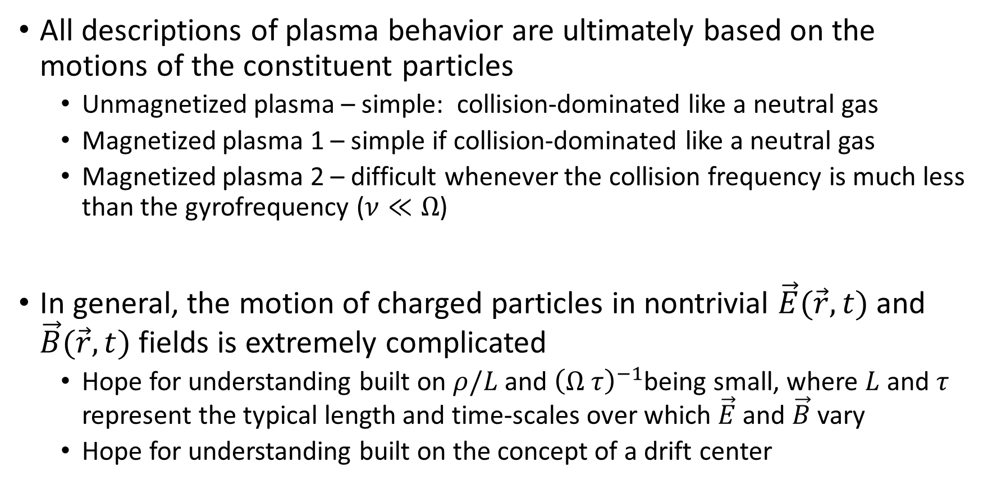
Single Particle Motion (1/n) – Hopes for Undertanding
All descriptions of plasma behavior are ultimately based on the motions of the constituent particles
Unmagnetized plasma – simple: collision-dominated like a neutral gas
Magnetized plasma 1 – simple if collision-dominated like a neutral gas
Magnetized plasma 2 – difficult whenever the collision frequency is much less than the gyrofrequency ($ν≪Ω$)
In general, the motion of charged particles in nontrivial $\vec{E}(\vec{r},t)$ and $\vec{B}(\vec{r},t)$ fields is extremely complicated
Hope for understanding built on $ρ/L$ and ${\left(Ω τ\right)}^{−1}$being small, where $L$ and $τ$ represent the typical length and time-scales over which $\vec{E}$ and $\vec{B}$ vary
Hope for understanding built on the concept of a drift center

Slide 4
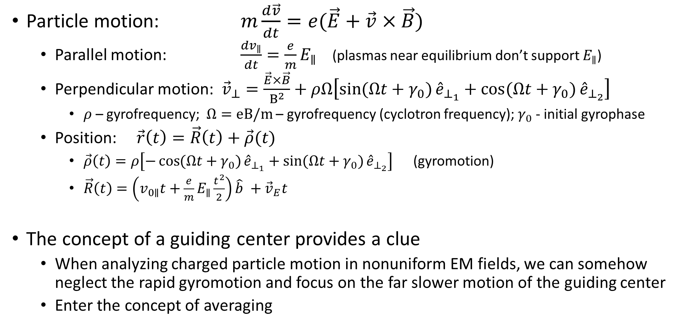
Single Particle Motion (2/n) – Drift Center
Particle motion: $m\frac{d\vec{v}}{dt}=e(\vec{E}+\vec{v}×\vec{B})$
Parallel motion: $\frac{dv_{∥}}{dt}=\frac{e}{m}E_{∥}$ (plasmas near equilibrium don’t support $E_{∥}$)
Perpendicular motion: ${\vec{v}}_{⊥}=\frac{\vec{E}×\vec{B}}{B^{2}}+ρΩ\left[\sin{(Ωt+γ_{0})}{\hat{e}}_{⊥_{1}}+\cos{(Ωt+γ_{0})}{\hat{e}}_{⊥_{2}}\right]$
$ρ$ – gyrofrequency; $Ω=eB/m$ – gyrofrequency (cyclotron frequency); $γ_{0}$ - initial gyrophase
Position: $\vec{r}\left(t\right)=\vec{R}\left(t\right)+\vec{ρ}(t)$
$\vec{ρ}\left(t\right)=ρ\left[−\cos{(Ωt+γ_{0})}{\hat{e}}_{⊥_{1}}+\sin{(Ωt+γ_{0})}{\hat{e}}_{⊥_{2}}\right]$ (gyromotion)
$\vec{R}\left(t\right)=\left(v_{0∥}t+\frac{e}{m}E_{∥}\frac{t^{2}}{2}\right)\hat{b} +{\vec{v}}_{E}t$
The concept of a guiding center provides a clue
When analyzing charged particle motion in nonuniform EM fields, we can somehow neglect the rapid gyromotion and focus on the far slower motion of the guiding center
Enter the concept of averaging

Slide 5
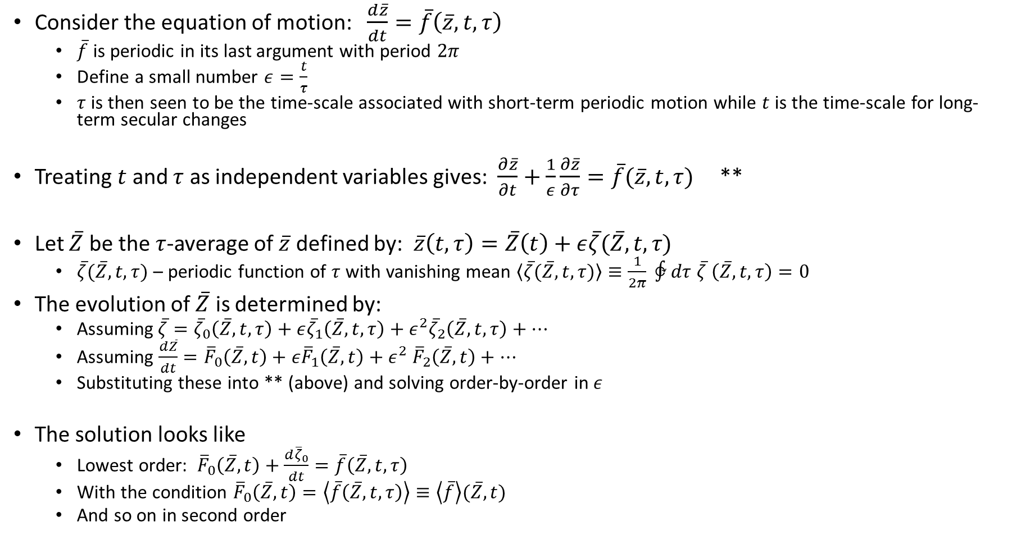
Single Particle Motion (3/n) – Method of Averaging
Consider the equation of motion: $\frac{d\overline{z}}{dt}=\overline{f}\left(\overline{z},t,τ\right)$
$\overline{f}$ is periodic in its last argument with period $2π$
Define a small number $ε=\frac{t}{τ}$
$τ$ is then seen to be the time-scale associated with short-term periodic motion while $t$ is the time-scale for long-term secular changes
Treating $t$ and $τ$ as independent variables gives: $\frac{∂\overline{z}}{∂t}+\frac{1}{ε}\frac{∂\overline{z}}{∂τ}=\overline{f}(\overline{z},t,τ)$ **
Let $\overline{Z}$ be the $τ$-average of $\overline{z}$ defined by: $\overline{z}\left(t,τ\right)=\overline{Z}\left(t\right)+ε\overline{ζ}(\overline{Z},t,τ)$
$\overline{ζ}(\overline{Z},t,τ)$ – periodic function of $τ$ with vanishing mean $\left\langle \overline{ζ}(\overline{Z},t,τ)\right\rangle ≡\frac{1}{2π} ∲dτ \overline{ζ} \left(\overline{Z},t,τ\right)=0$
The evolution of $\overline{Z}$ is determined by:
Assuming$\overline{ζ}={\overline{ζ}}_{0}\left(\overline{Z},t,τ\right)+ε{\overline{ζ}}_{1}\left(\overline{Z},t,τ\right)+ε^{2}{\overline{ζ}}_{2}\left(\overline{Z},t,τ\right)+⋯$
Assuming $\frac{d\overline{Z}}{dt}={\overline{F}}_{0}\left(\overline{Z},t\right)+ε{\overline{F}}_{1}\left(\overline{Z},t\right)+ε^{2} {\overline{F}}_{2}\left(\overline{Z},t\right)+⋯$
Substituting these into ** (above) and solving order-by-order in $ε$
The solution looks like
Lowest order: ${\overline{F}}_{0}\left(\overline{Z},t\right)+\frac{d{\overline{ζ}}_{0}}{dt}=\overline{f}\left(\overline{Z},t,τ\right)$
With the condition ${\overline{F}}_{0}\left(\overline{Z},t\right)=\left\langle \overline{f}\left(\overline{Z},t,τ\right)\right\rangle ≡\left\langle \overline{f}\right\rangle (\overline{Z},t)$
And so on in second order

